Slide 1

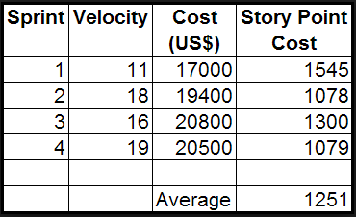
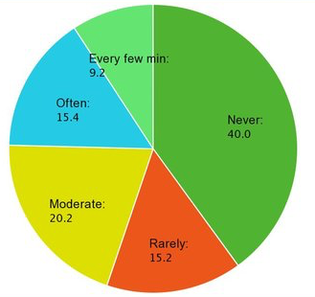
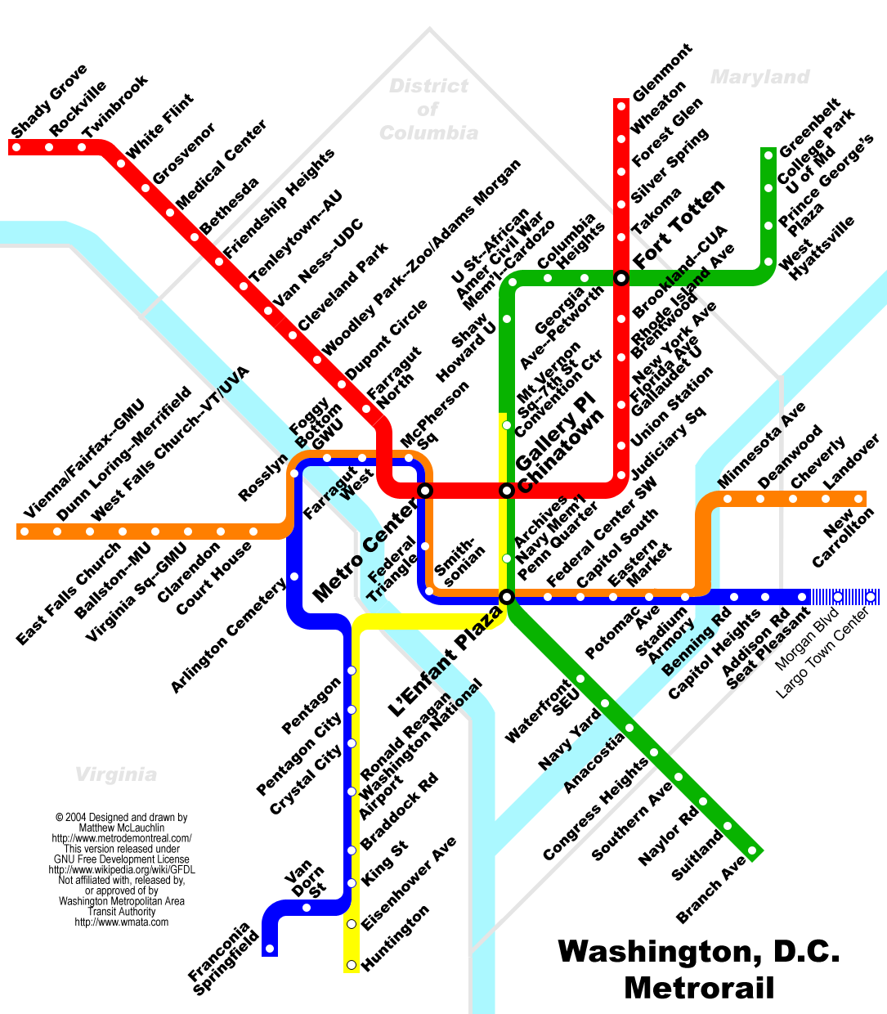
Title of your work, first letter capitalized, in 84 point font-size, and left-aligned (Font: Times New Roman)
Ke-Haur Taur¹, Wei-Fan Tseng¹, Kai-Chen Kuo¹, Bo-Ray Yeh¹
¹Electrical and Computer Engineering, University of Michigan, Ann Arbor, Michigan.
Introduction
Approach/Design
Table 1: Text in Arial font size 20.
If you are including a table/figure wrapped with the text, ensure at least a 0.50 inch gap between the edge of the table and the text box/caption box, as is demonstrated by this text box and the table on the left.
Make the table as simple as possible and without any unnecessary embellishments. A simple black/white format will ensure uniformity across posters.
All text in the body of the poster should be in Arial. Font sizes for each text subtype have been mentioned. Body text should have a font size of 32, while Figure and Table captions should have a font size of 20. All text must be JUSTIFIED to both the left and right edges of the text box.
If you are including a figure wrapped with the text, ensure at least a 0.50 inch gap between the edge of the figure and the text box/caption box, as is demonstrated by this text box and the figure on the right.
The headers on this template can be moved as seen fit. The color of the boxes and text for the headers can be changed. The background must remain white.
Ensure that the following guidelines are maintained:
0.5 inch gap between the end of a text box and the start of the box for the next section’s underlined subheading.
0.5 inch gap between the underlined subheadings and the start of the text box for the main text.
Maintain all the guidelines set for the poster edges and the gaps between each columns. You may adjust column widths SLIGHTLY to fit in your information, but make sure this change is compensated for elsewhere. The overall look of the poster must not vary significantly.
You can view all the guidelines by right clicking on the slide>>Grid and Guides>>select Guides or use Alt+F9.
The organization of information and figures/tables within each subsection can be done at your discretion, this is just a suggested guideline. Just do not alter the formatting guidelines so that each poster that we print has a relatively uniform look.
Results/Modeling
This section can be a mixture of results and expected results generated via computational modelling or other theoretical methods
Present your results here. Because pictures are worth all those thousands of words, you may want to use a few figures.
Try to use Arial in your figures as this will make them look more at home in this template.
Discussion and Conclusions
Miscellaneous bits of information that might be of use:
Text size:
Title: 84pt
Authors section: 48pt
Headings: 54pt
Body text 32pt
Captions: 20pt
Body columns: 14” wide, justified text
Margins are 2” on the outer-side and 1” between the columns
To toggle gridlines in PowerPoint:
On Windows use shortcut “Alt-F9”
On Mac: Home > Arrange > Align > View Gridlines or View > Guides > Static guides
Note that poster title MUST be the same as abstract title!!
Figure 1: Text in Arial font size 20. Chart represents a survey on the use of social media for a business.
Acknowledgements
Objectives
Be sure to list anyone you wish to thank and acknowledge any funding that made this work possible.
The section headings that follow are to be used at your discretion.
We have included suggested standard headings. Make sure you include enough information to explain the motivation/concept, the experimental procedure, the results, and what can be concluded.
Do so briefly. You should avoid overly crowding the poster.
You are free to use any mathematical typesetting software you like, just be sure to make it look professional.
This is your presentation. It reflects your effort.
References
Figure 2: Text in Arial font size 20. Something that would be nearly impossible to describe in words alone.

